Slide 1
Intellij Idea Tips & Tricks

Slide 2
Agenda
Installation
Keyboard shortcuts
Configurations
Live Templates
File Templates

Slide 3
Installation
Download Intellij trial version tar file from https://www.jetbrains.com/idea/download/download-thanks.html?platform=linux
Untar folder to /opt folder
Create soft link in /opt folder with the name idea
Update .bashrc file and add /opt/idea/bin in PATH variable
export PATH=$PATH:/opt/idea/bin
Now run idea.sh in terminal

Slide 4
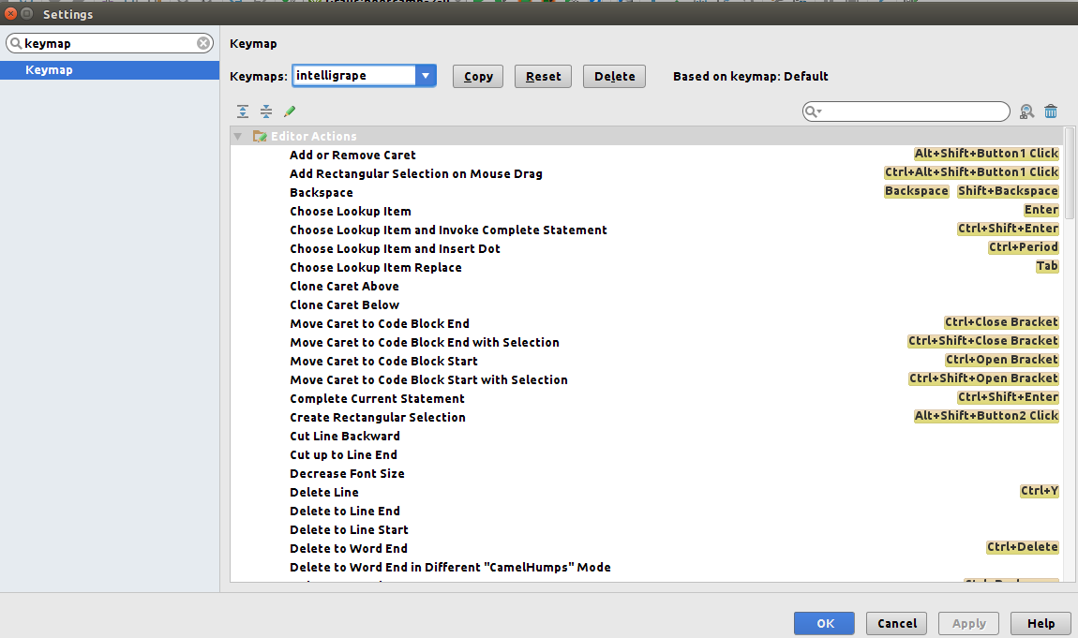
Keyboard shortcuts
Add keymap file to
~/.IntelliJ/config/keymaps
Create keymaps folder if it doesn’t exist
Now go to Idea,
File -> Settings, Search keymaps and select intelligrape file

Slide 5
Keyboard shortcuts
Key | Description
Ctrl + Alt +M | Extract method
Ctrl + Alt + T | Surround with (eg. Try/catch)
Alt + UP/Down | Scroll through Methods
Shift + F6 | Rename variable, method, class
Shift + Ctrl + UP/Down | Move/arrange lines/methods UP/Down
Ctrl + Shift + I | See method definition in a popup
Ctrl + B | Go to the definition of the method
Ctrl + Shift + O | List of methods in a file

Slide 6
Keyboard shortcuts
Key | Description
Ctrl + P | See parameters of the method
Ctrl + shift + backspace | Move to the statement last edited.
Ctrl + / | Comment single line
Ctrl + shift + / | Comment block of code
Ctrl + H | See class hierarchy
Ctrl + W | Select a word
Ctrl + F | Search word
Ctrl + R | Search and replace word

Slide 7
Keyboard shortcuts
Key | Description
Ctrl + Shift + F7 | Highlight usages of a variable/method
Ctrl + shift + E | Recently edited files
Ctrl + E | Recently opened files
Ctrl + D | Duplicate line
Ctrl + Y | Delete a line
Alt + Enter | Import class
Ctrl + Space | Basic code completion (the name of any class, method or variable)
Ctrl + F4 | Close active editor tab

Slide 8
Keyboard shortcuts
Key | Description
Ctrl + Shift + N | Go to file
Ctrl + Alt + L | Format code
Ctrl + G | Go to Line Number
Ctrl + Click | Go to class, method or variable definition
Alt + Delete | Safe Delete variable, class, method, file
Ctrl + Alt + O | Optimize import
Ctrl + Shift + J | Join two lines
Ctrl + Shift + V | Paste from buffer which has last 5 copied statements

Slide 9
Keyboard shortcuts
Key | Description
Alt + J | Select next occurrence
Ctrl + Alt + Shift + J | Select all occurrences
Alt + Shift + J | Unselect occurrence
Ctrl + Shift + Alt + Insert | Open Scratch Pad

Slide 10
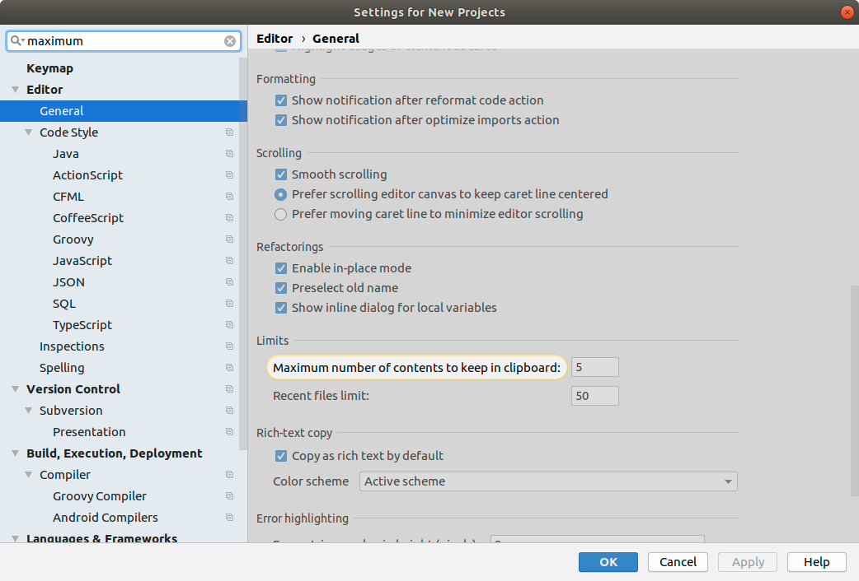
Keyboard shortcuts

Slide 11
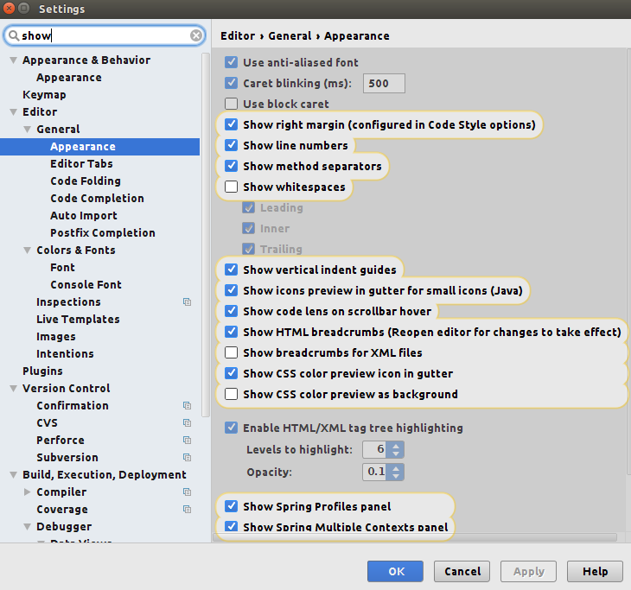
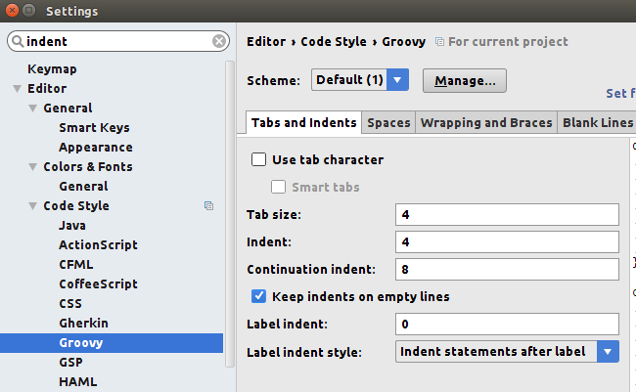
Configurations
Show line numbers
Show Method separator
Show right margin
Indentation 4,4,8

Slide 12
Configurations
Change JDK version
File -> Project Structure -> Project
Change Grails SDK
Tools -> Grails -> Change SDK Version
Enable version control
VCS -> Enable version control
Idea also has it’s own local history
Right click -> Local History

Slide 13
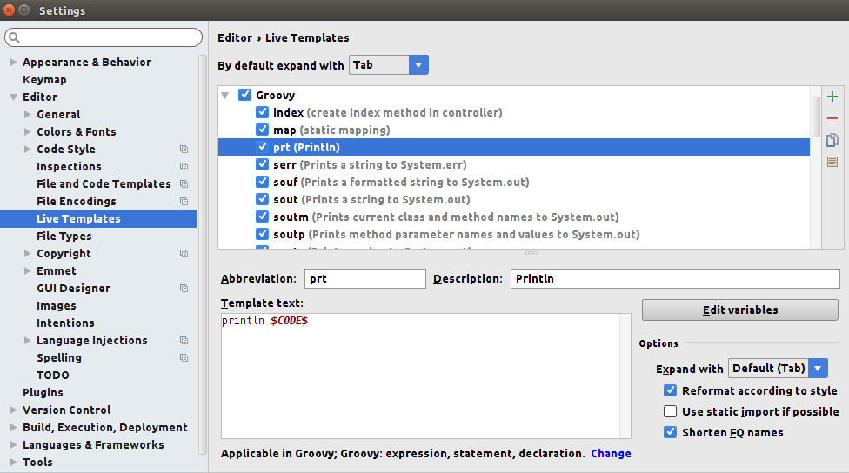
Live Templates

Slide 14
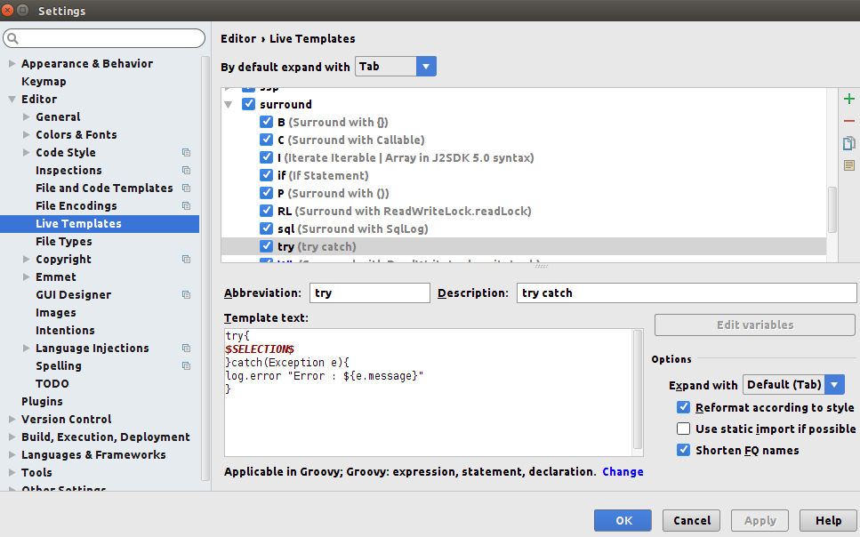
Live Templates

Slide 15
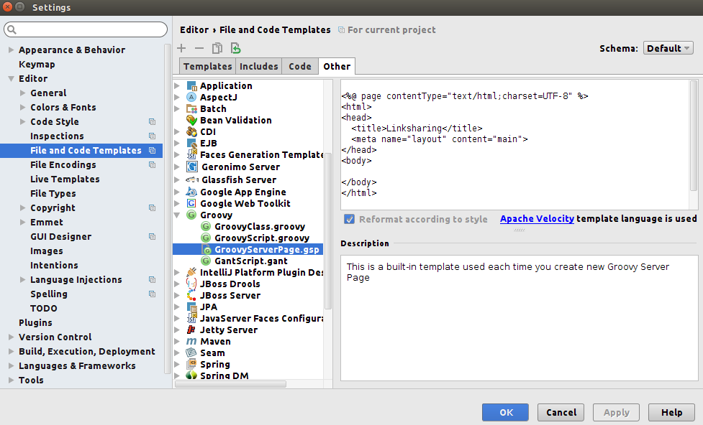
File Template
Remove content of File header in include
Update GSP template

Slide 16
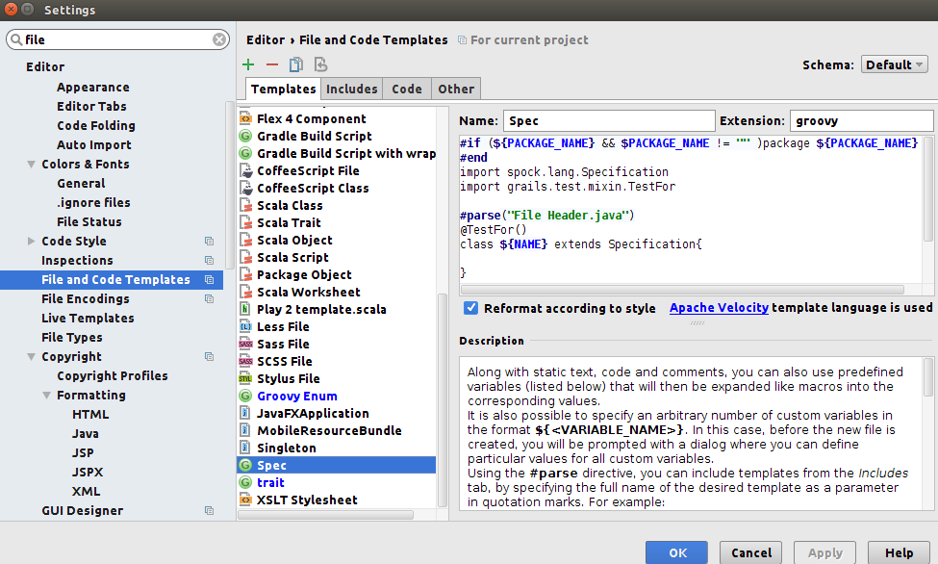
File Template
Create your own file template

Slide 17
File Template
#if (${PACKAGE_NAME} && $PACKAGE_NAME != "" )package ${PACKAGE_NAME}
#end
#parse("File Header.java")
enum ${NAME} {
final String name
${NAME}(String name){
this.name = name
}
String toString(){
return name
}
String getKey(){
return name()
}
String getValue(){
return name
}
static List<${NAME}> list(){
return ${NAME}.values()
}
}
Create a groovy Enum class

Slide 18
Questions??

Slide 19
Exercise
Increase maximum copy history to 50
Enable show line number, method separator, right margin
Indentation of 4,4,8
Create Live Templates
prt for println
swt for setup: when: then:
surround with try catch
surround with if

Slide 20
Thank You!

